Slide 1
INTRODUCTION
Network security consists of the policies, processes and practices adopted to prevent, detect and monitor unauthorized access, misuse, modification, or denial of a computer network and network-accessible resources. Network security involves the authorization of access to data in a network, which is controlled by the network administrator. Users choose or are assigned an ID and password or other authenticating information that allows them access to information and programs within their authority

Slide 2
SEC285 Module 2 Asymmetric Key Encryption

Slide 3
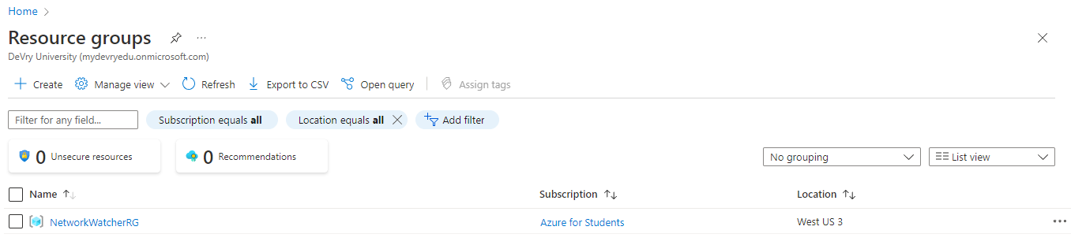
File Encryption
This screenshot should show the following.
Content of the plaintext file
Content of the encrypted file

Slide 4
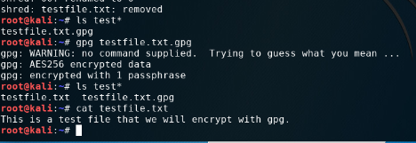
File Decryption
This screenshot should show the following.
The encrypted file being listed by itself
The decrypting process
Both the encrypted file and the original plaintext file being listed

Slide 5
SEC285 Module 3 Stateful Firewall

Slide 6
Question
What effect does the sudo iptables --policy INPUT DROP command have on the access to computing resources?
Answer here:
The iptables -P INPUT DROP is known to be an -P switch that places the default policy on any given chain.
References: google
Virtual machine
nannija

Slide 7
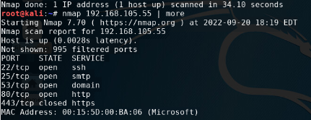
Nmap Scan
This screenshot should show the Nmap scan result of the Linux Server VM.

Slide 8
SEC285 Module 5 Multifactor Authentication (MFA)

Slide 9
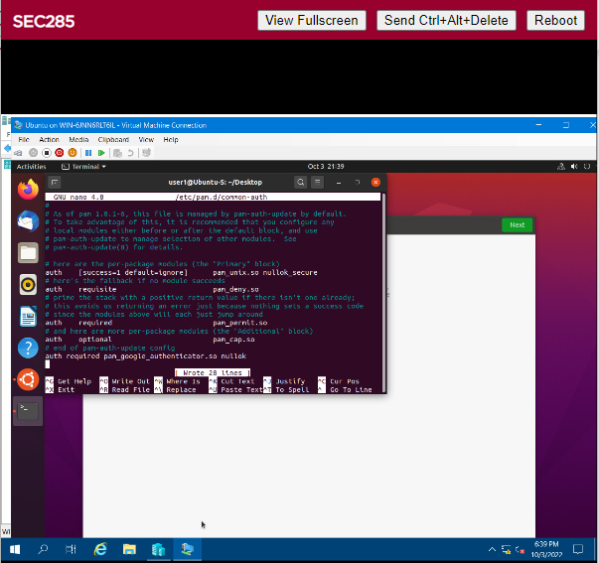
Common-auth Configuration File
This screenshot should show the entry that indicates the use of the Google Authenticator module.

Slide 10
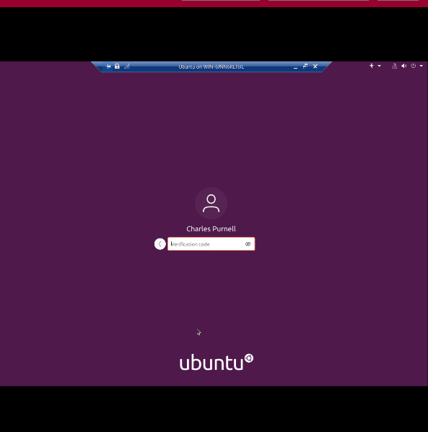
MFA Logon Screen
This screenshot should show the logon screen where a verification code is required.
I ended up changing its name to mine on accident

Slide 11
SEC285 Module 6 Vulnerability Assessment

Slide 12
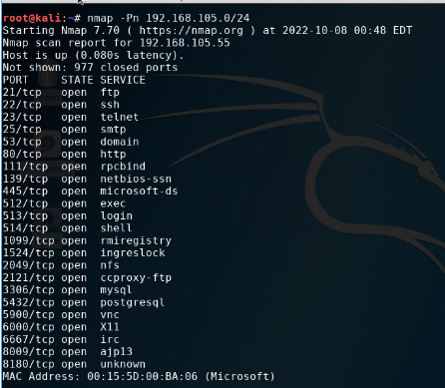
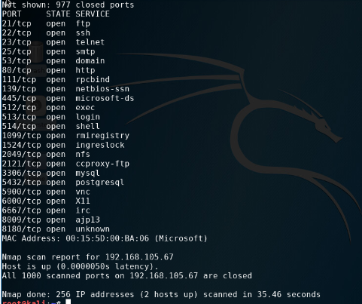
Nmap
This screenshot should include the scan result showing both the Kali and Linux Server VMs.

Slide 13

NetCat
This screenshot should include the scan result showing both the Kali and Linux Server VMs.

Slide 14
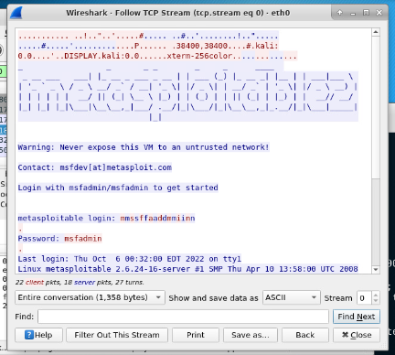
Wireshark
This screenshot should include the Wireshark—Follow TCP Steam window showing the Telnet username and password.

Slide 15
SKILLS LEARNED IN SYSTEM SECURITY
1) Set up Strong Passwords: To protect your system or network from malicious attacks, firstly put a strong password in your system for login and access and the password must consist of lots of characters, symbols, and numbers.
2) Establish a Firewall
3) Antivirus Protection
4) Updating
5) Guard Laptops and Mobile Phones

Slide 16
CHALLENEGES
The biggest challenges was the coding part and making sure the punctuation was right or the command wouldn’t work. Also making sure you use the right server for the right terminal when pinging or trying to connect between to terminal and most importantly remembering your password to everything you change.

Slide 17
CONCLUSION
This will help me with my problem-solving skill while staying logical and being a more motivated problem solver. It’s one of the biggest requirements of numerous IT roles. PayScale specified that information systems managers today must be able to resolve situations satisfactorily, no matter how complicated or difficult they become. This is a matter of logic, attention to detail, and critical-thinking skills as much as tech knowledge.

